Slide 1
Payconiq’s toolkit for charities

Slide 2
WHY THIS TOOLKIT?
These days, people tend to be in a rush most of the time, so you must make things as easy as possible for them. The ‘Scan & Donate’ solution is a good way to start. And to introduce it, we created this toolkit for you.
In the toolkit, you’ll find some examples of how you can integrate the Payconiq QR code in your internal and external communication and tips to explain your audience how they can donate to your good cause.
The ‘Scan & Donate’ solution is more than just a QR code. It creates new, original and interactive ways to collect donations for your organization. And as new methods require an introduction, we are happy to give you this toolkit.
2

Slide 3
WHAT’S IN THE TOOLKIT
The basics
1
3
Communication
on website
- Colors
- Fonts
- Logos and how to use them
- Use among other acceptance marks
- QR code
- How to donate
4
Social media
2
Communication
material
- Internal
- External
3

Slide 4
1
The basics
The basics to communicate about Payconiq and Payconiq by Bancontact:
colors, fonts, logo use and QR code

Slide 5
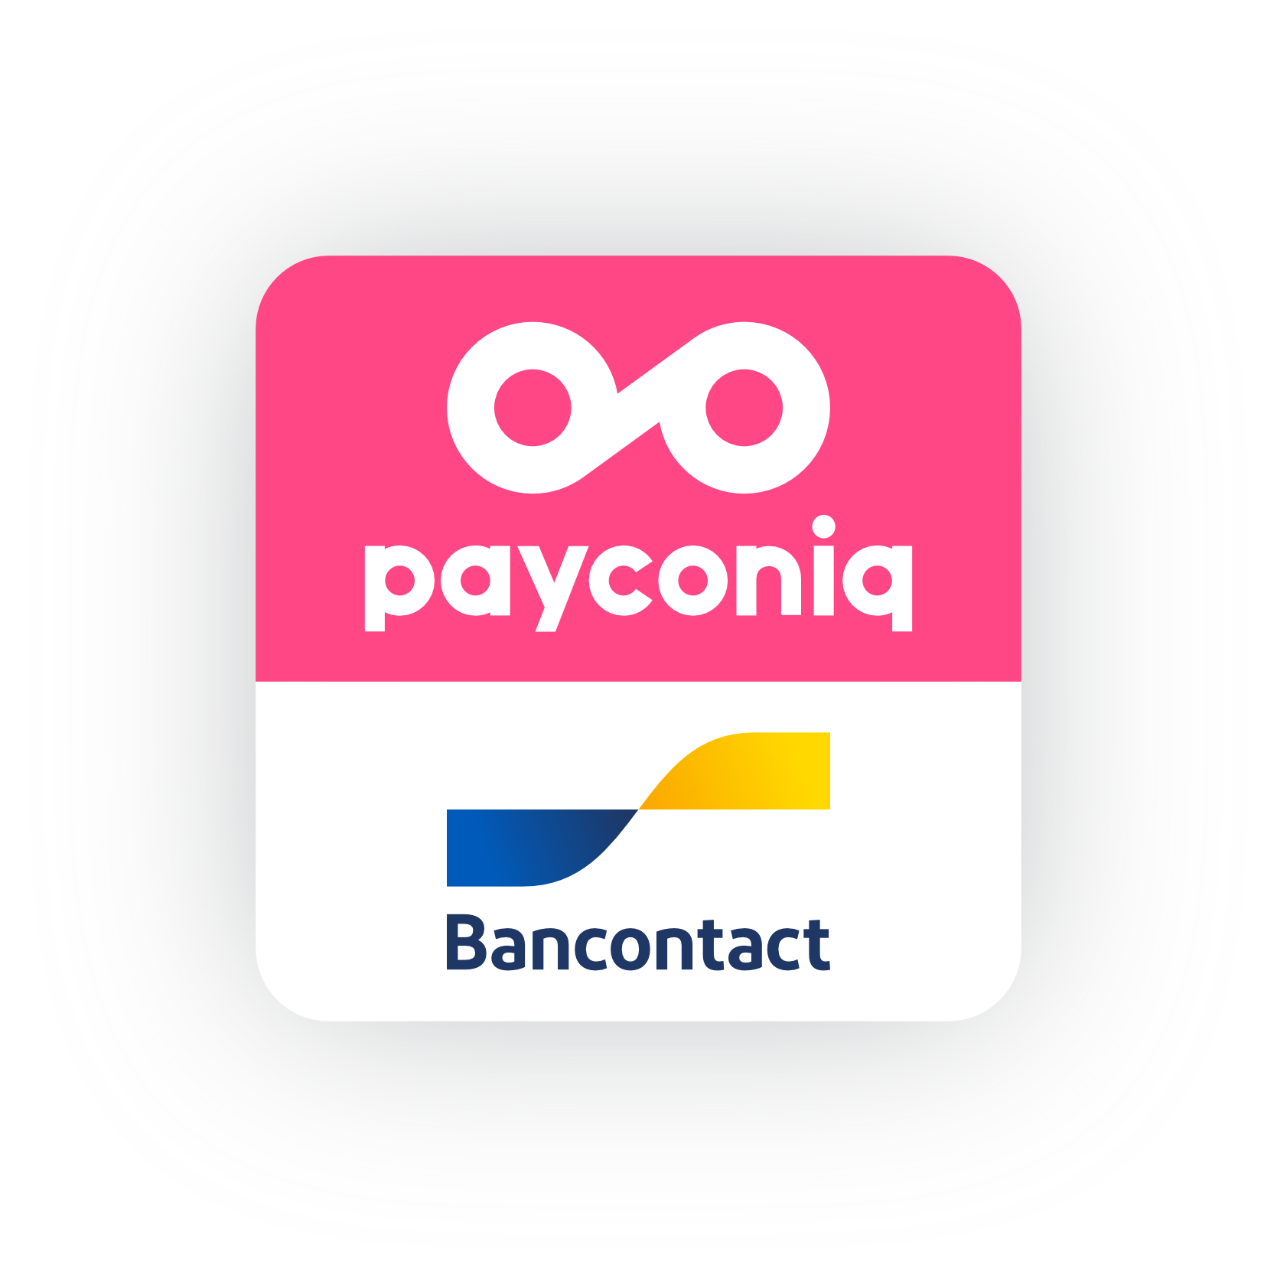

Since June 2018, Payconiq and Bancontact have joined forces. This resulted in a new product, the Payconiq by Bancontact app: a unified and amazing app that offers the best of both worlds (and which replaced the individual Bancontact and Payconiq apps). We make a distinction between the payment method ‘Payconiq’ and the app ‘Payconiq by Bancontact’. People can also use other banking apps that support Payconiq as a payment method.
Payconiq
Payconiq by Bancontact
‘Payconiq’ is used when referring to the payment method accepted by the merchant (and shown through the ‘Payconiq’ acceptance mark).
‘Payconiq by Bancontact’ is used when referring to the Payconiq by Bancontact app consumers use to pay with.
5

Slide 6
COLORS
Magenta
Yellow
Dark blue
White
PMS 205 C
CMYK 0/83/17/0
RGB 255/71/133
HEX #FF4785
PMS 102 C
CMYK 0/10/100/0
RGB 249/220/10
HEX #F9DC0A
PMS 282 C
CMYK 100/90/5/35
RGB 11/34/101
HEX #0B2265
PMS White
CMYK 0/0/0/0
RGB 255/255/255
HEX #FFFFF
* Standard CMYK printing will not give a satisfactory result. We suggest that all printed applications will be produced in 5 color printing.
7

Slide 7
FONTS
SOFIA PRO BLACK
ABCDEFGHIJKLMOPQRSTUVWXYZ
abcdefghijklmopqrstuvwxyz
123456789(.,;:?$€&@*)
Sofia Pro Black is used for huge titles
Sofia Pro Bold is used
for rather big titles
Sofia Pro Medium for subtitles
Sofia Pro Light for bodycopy
SOFIA PRO BOLD
ABCDEFGHIJKLMOPQRSTUVWXYZ
abcdefghijklmopqrstuvwxyz
123456789(.,;:?$€&@*)
SOFIA PRO MEDIUM
ABCDEFGHIJKLMOPQRSTUVWXYZ
abcdefghijklmopqrstuvwxyz
123456789(.,;:?$€&@*)
SOFIA PRO LIGHT
Arial as fallback font
In case the Sofia Pro font should not be available, you can use Arial as a fallback font.
ABCDEFGHIJKLMOPQRSTUVWXYZ
abcdefghijklmopqrstuvwxyz
123456789(.,;:?$€&@*)
7

Slide 8
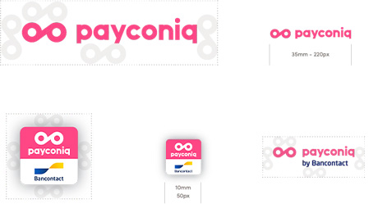
LOGOS AND HOW TO USE THEM
Horizontal Payconiq logo
Minimum size
Payconiq by Bancontact app icon
Minimum size
Protection zone
8

Slide 9


USE AMONG OTHER ACCEPTANCE MARKS
Since Payconiq is the number one mobile payment brand in Belgium, we always position the logo first in the list.
When both the Payconiq logo and the Bancontact logo
are used, they are preferably placed together.
Use the vertical logo when the
available width is limited.
9

Slide 10
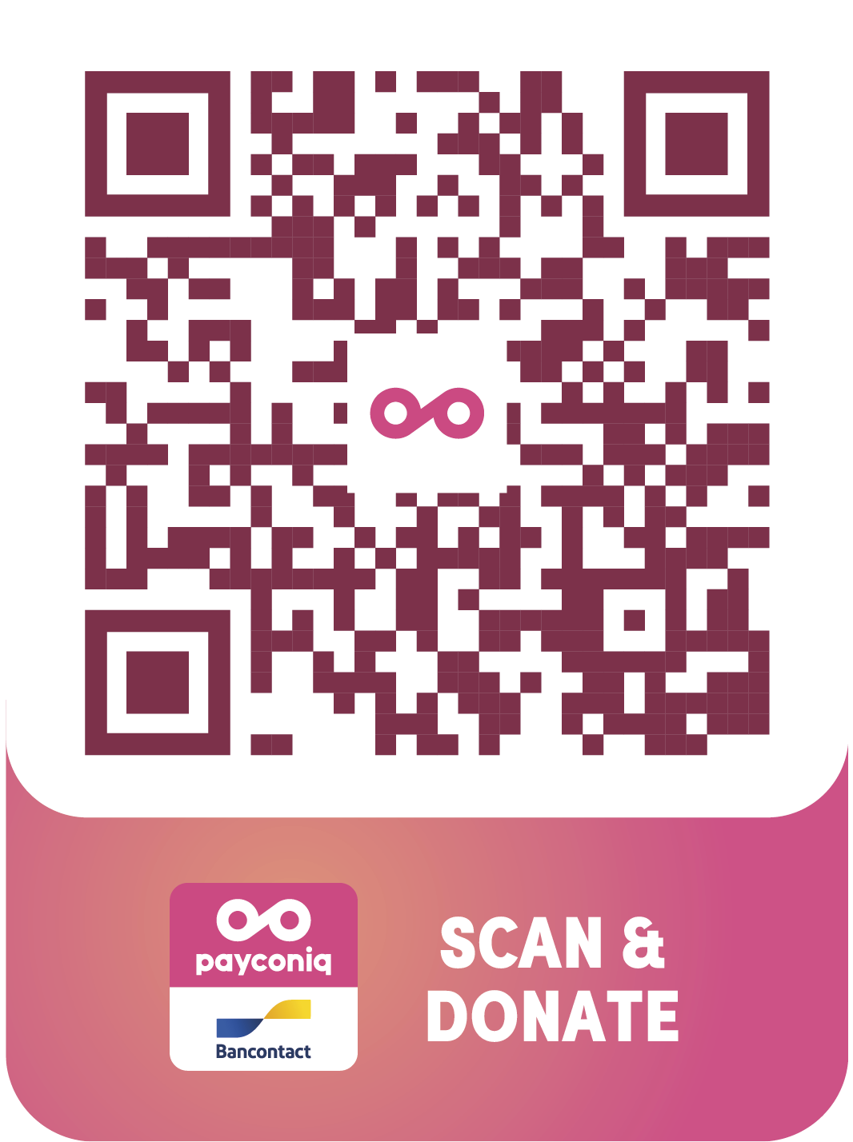
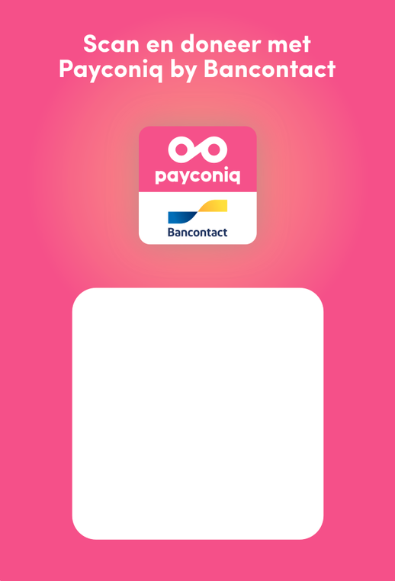
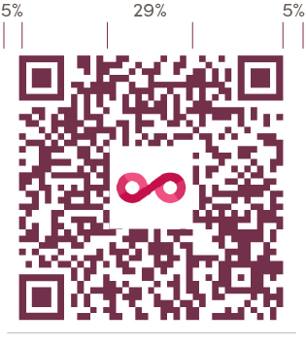
QR CODE
A modern and fresh magenta QR code.
The Payconiq QR code is a branded QR code with a Payconiq logo and Payconiq magenta color. The branding of the QR gives trust and makes it easy for our consumers to recognize that they can pay with Payconiq by Bancontact. Instead of black we use our darkest shade of magenta for the QR code to match our primary color but keeping the contrast.
Bordeaux
CMYK 40/88/52/29
RGB 123/49/74
HEX #7B314A
Min. 25 mm
Example
10

Slide 11
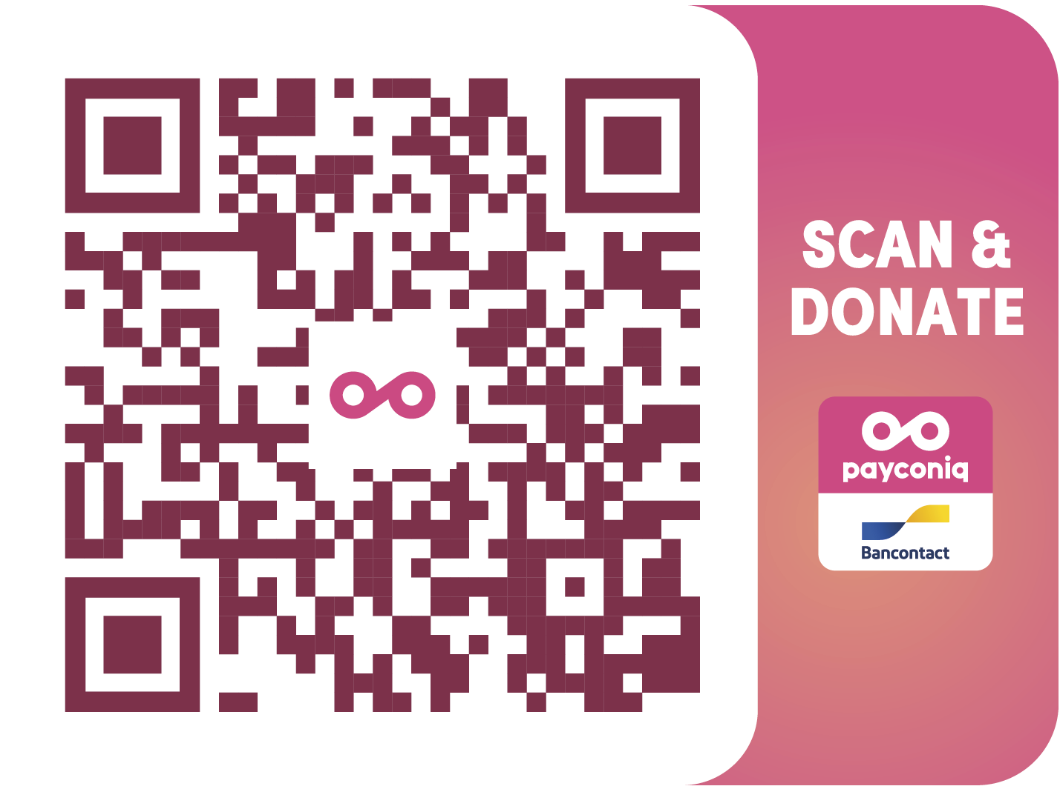
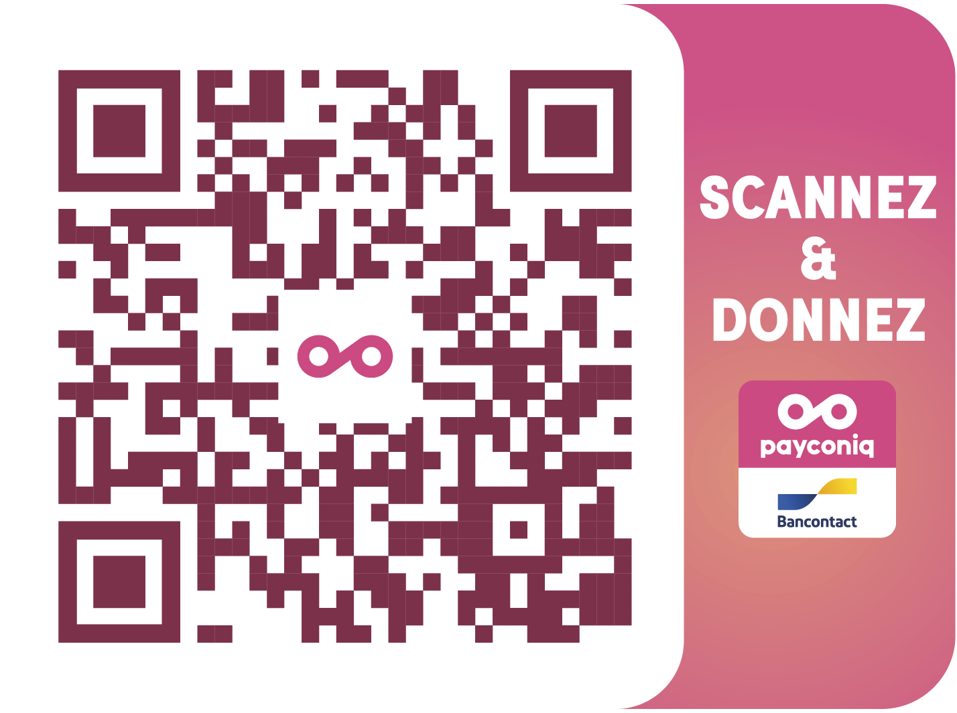
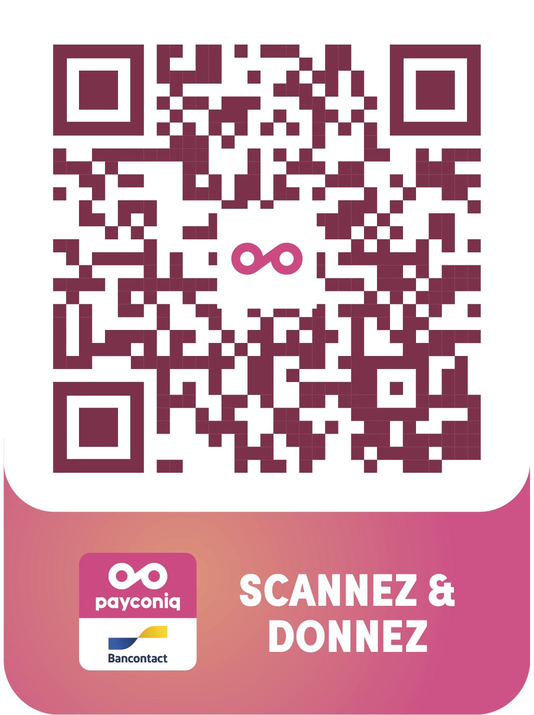
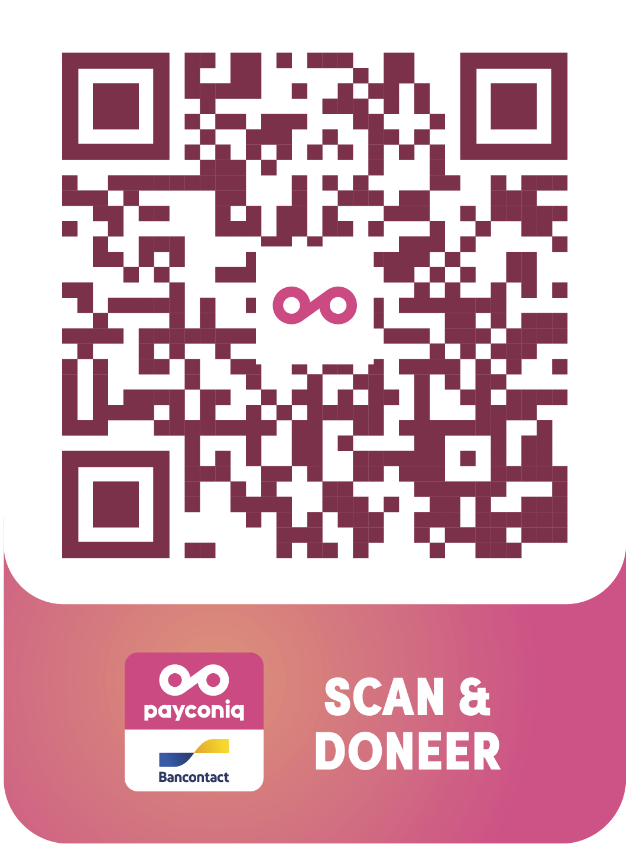
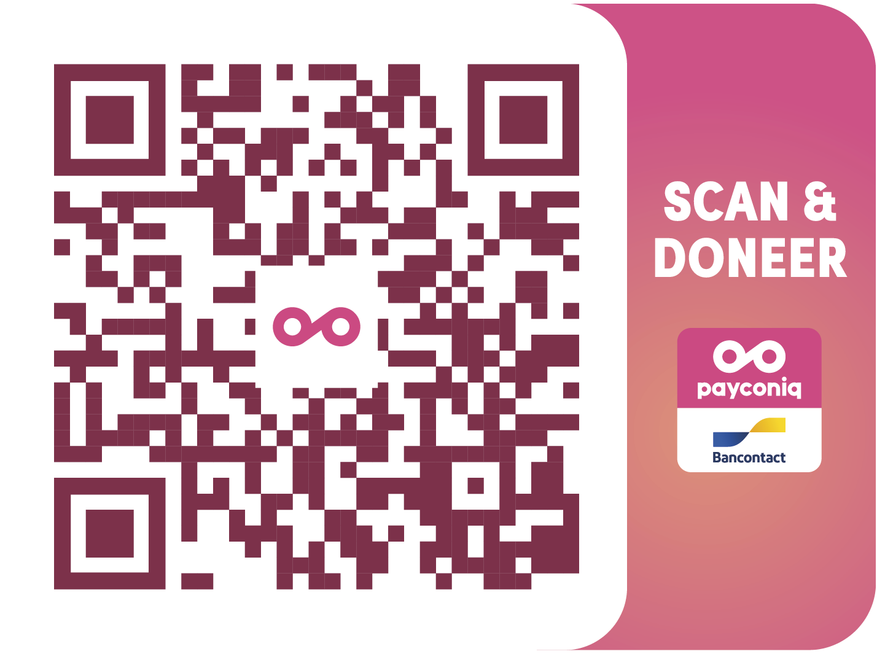
QR CODE
Your QR code will of course be personalized and mailed to you, but this is what it will look like. You can use it on folders, flyers, letters, T-shirts, festival wristbands, … or online on banners or your website.
11

Slide 12
HOW TO DONATE
Is it the first time your donors use the ‘Scan & Donate’ solution? We’ll integrate the detailed explanation in the communication material on the next slides, but you can find it here as well, in case you want to look something up quickly:
Via Desktop :
The donor scans the QR code and lands on a webpage with your logo.
After introducing (or confirming) the donation amount, the consumer can request to receive a tax certificate by leaving his personal details.
Via the ”Pay with Payconiq” button, the donor lands in his payment app.
After confirming his payment, the donor is redirected to a ‘Thank you’ page.
All donor details needed to issue a tax certificate will be available for download on the portal at the end of the month.
Via Mobile:
Mobile websites, applications or campaigns where the donor is already on a mobile device (and thus not able to scan a QR code) must have a 'donate' button that redirects the user to your donation page. You can simply implement the URL of the project into the button and your donors will land on your donation page.
12

Slide 13
2
Communication material
You can use this to implement Payconiq in your internal
and external communication

Slide 14
Internal communication
Let your employees and volunteers know they can now use Payconiq as a payment solution to collect donations with the Payconiq by Bancontact app or another banking app that supports Payconiq

Slide 15
Internal letters, mailings
and news item
Letters, mailings and news item you can use to let your employees and volunteers know that mobile donations are now an option with the Payconiq by Bancontact app or another banking app that supports Payconiq

Slide 16
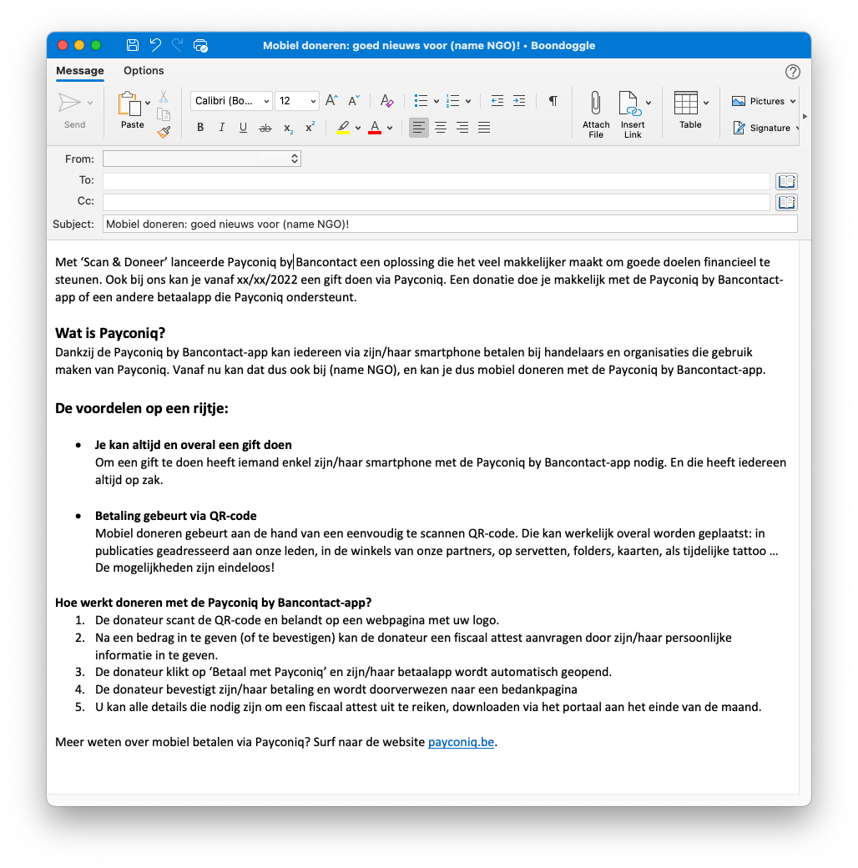
LETTER OR MAILING : ANNOUNCING PAYCONIQ BY BANCONTACT NL
You can use this internal mailing or letter to announce to your employees and volunteers that mobile donations are now an option via Payconiq. This mailing can either be integrated into an existing mail or serve as a news flash.
Please adapt as you wish to the TOV of your organization.
16
Notes:
Nieuw: mobiel doneren met Payconiq by Bancontact
Met ‘Scan & Doneer’ lanceerde Payconiq by Bancontact een oplossing die het veel makkelijker maakt om goede doelen financieel te steunen. Ook bij ons kan je vanaf xx/xx/2022 een gift doen via Payconiq. Een donatie doe je makkelijk met de Payconiq by Bancontact-app of een andere betaalapp die Payconiq ondersteunt.
Wat is Payconiq?
(huidige tekst behouden)
Welke voordelen biedt Payconiq?
(huidige tekst behouden)
Hoe werkt doneren met de Payconiq by Bancontact-app?
1. De donateur scant de QR-code en belandt op een webpagina met uw logo.
2. Na een bedrag in te geven (of te bevestigen) kan de donateur een fiscaal attest aanvragen door zijn/haar persoonlijke informatie in te geven.
3. De donateur klikt op ‘Betaal met Payconiq’ en zijn/haar betaalapp wordt automatisch geopend.
4. De donateur bevestigt zijn/haar betaling en wordt doorverwezen naar een bedankpagina
5. U kan alle details die nodig zijn om een fiscaal attest uit te reiken, downloaden via het portaal aan het einde van de maand.
Meer weten over mobiel betalen via Payconiq? Surf naar de website payconiq.be.

Slide 17
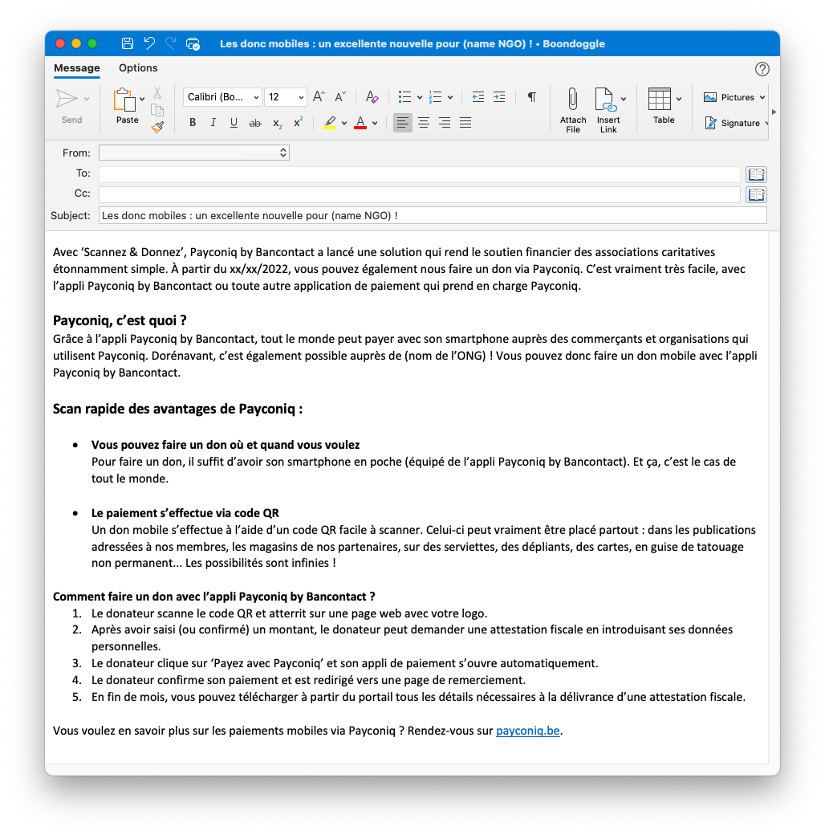
LETTER OR MAILING : ANNOUNCING PAYCONIQ BY BANCONTACT FR
You can use this internal mailing or letter to announce to your employees and volunteers that mobile donations are now an option via Payconiq. This mailing can either be integrated into an existing mail or serve as a news flash.
Please adapt as you wish to the TOV of your organization.
.
17

Slide 18
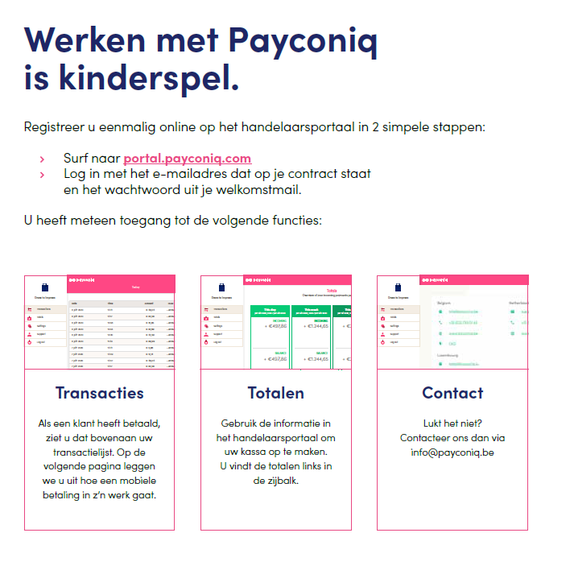
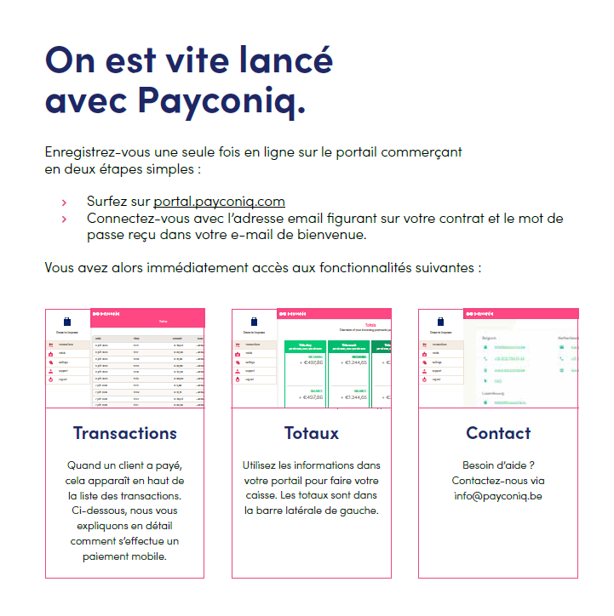
MANUAL FOR MERCHANTS NL and FR
In order to track QR code payments, you can visit the user-friendly merchant portal as referred to in the mailing. This manual shows you how it works:
20

Slide 19
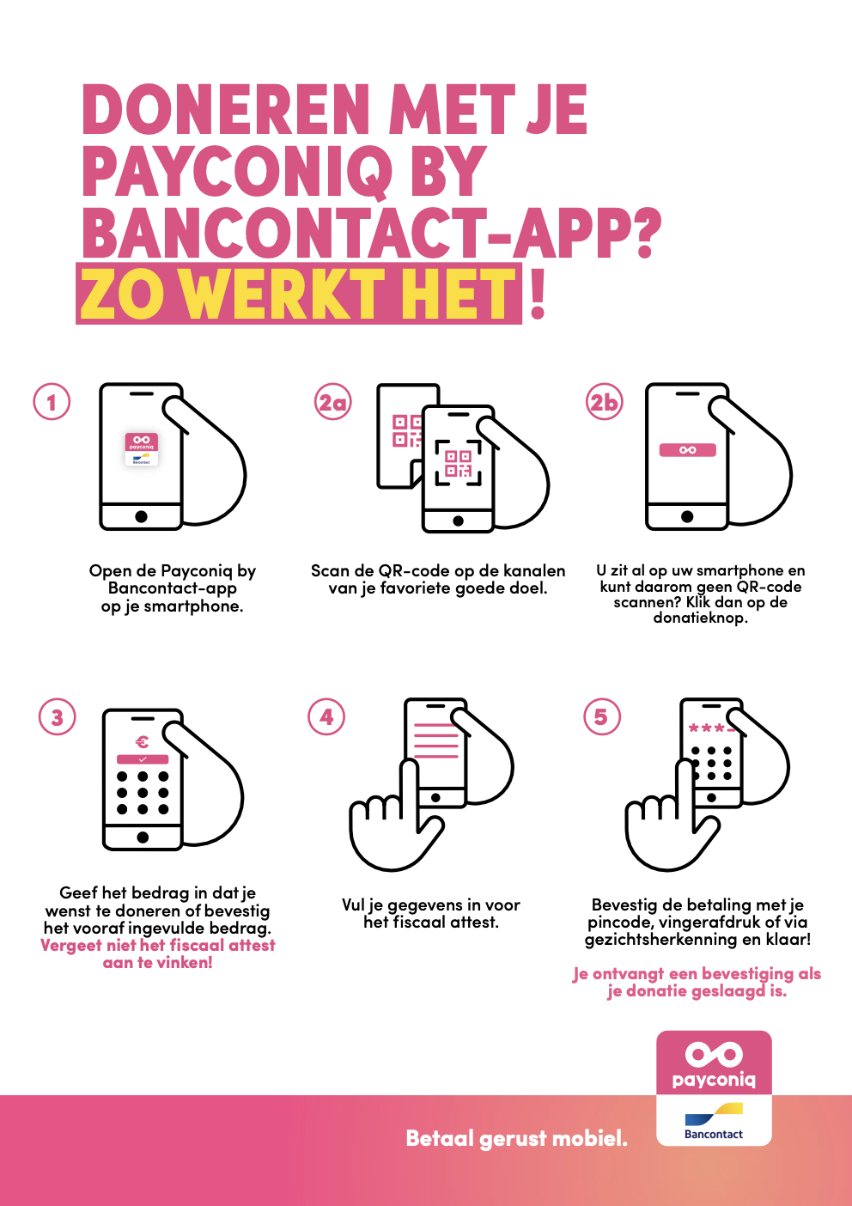
MANUAL FOR CONSUMERS NL
To make sure that it is clear how the Payconiq by Bancontact app works it might be interesting to add this manual to your mail. You can simply implement the manual into your email by adding this sentence:
“Ontdek hieronder hoe makkelijk het is om mobiel te doneren via de Payconiq by Bancontact-app.”
21

Slide 20
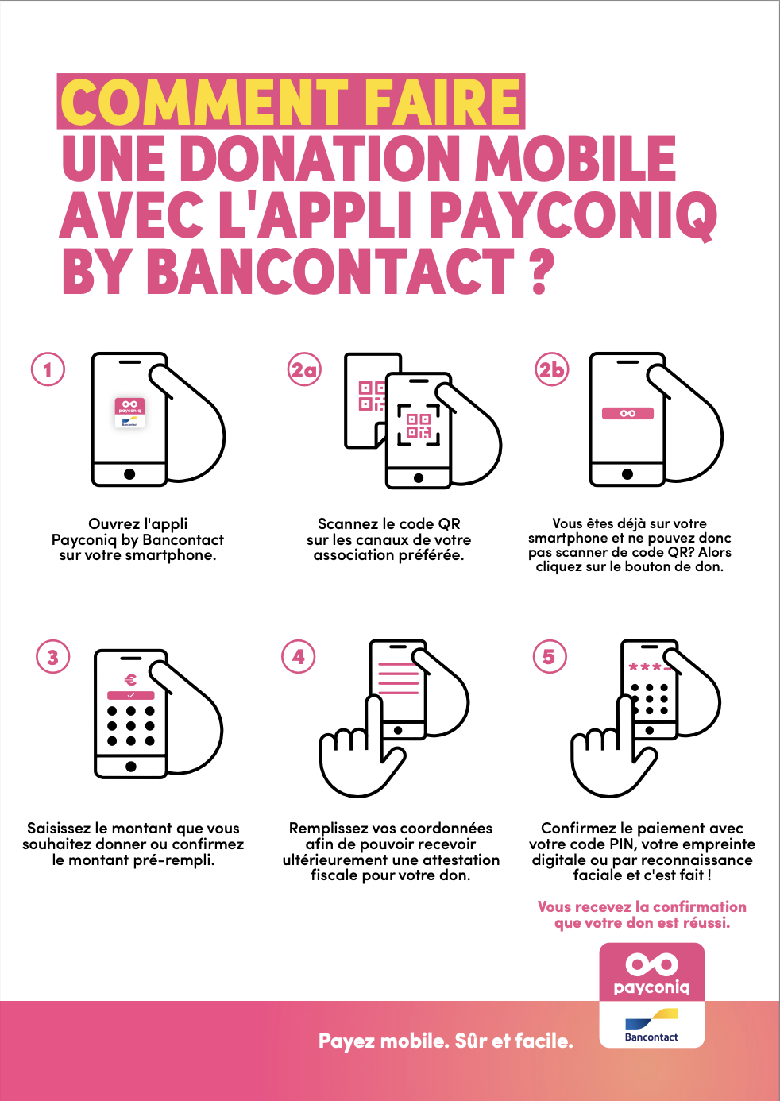
MANUAL FOR CONSUMERS FR
To make sure that it is clear how the Payconiq by Bancontact app works it might be interesting to add this manual to your mail. You can simply implement the manual into your email by adding this sentence:
“Découvrez ci-dessous comme il est facile de faire un don mobile via l’appli Payconiq by Bancontact.”
22

Slide 21
Internal promotional material
This material can be used on a visual to let your employees and volunteers know that Payconiq is now an option to collect donations

Slide 22
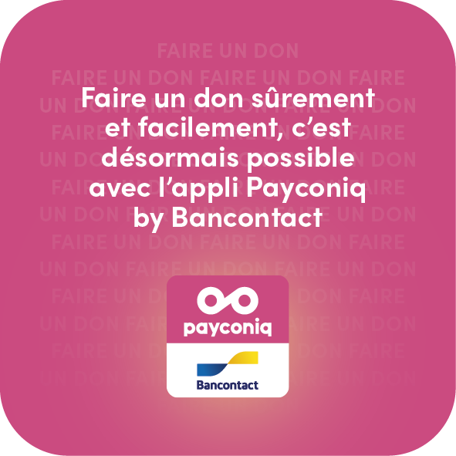
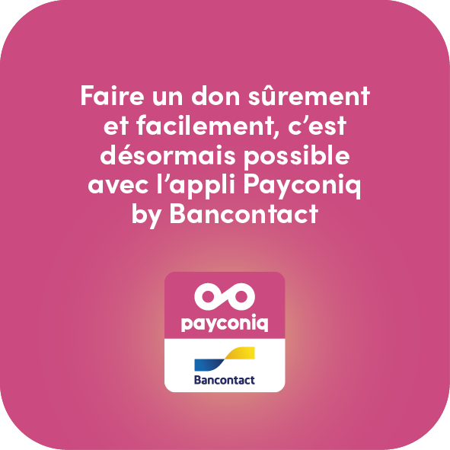
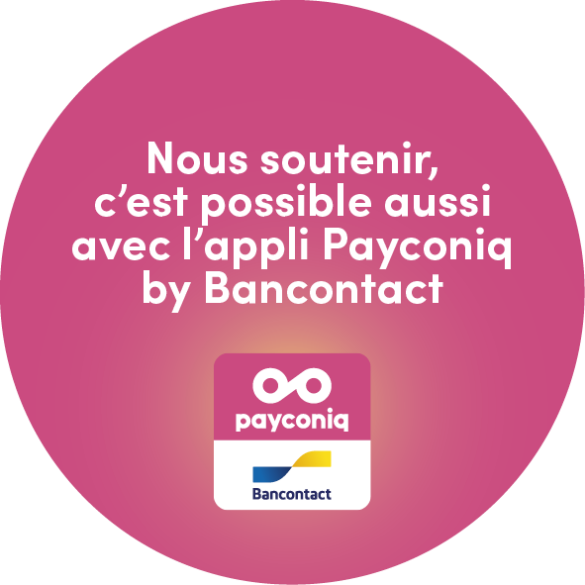
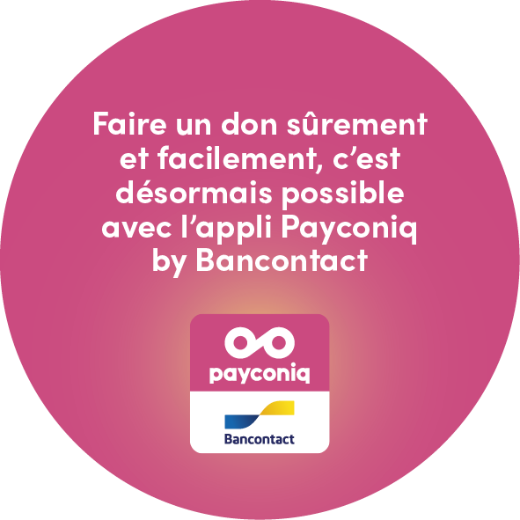
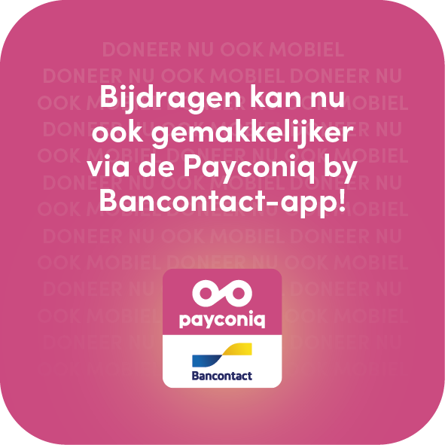
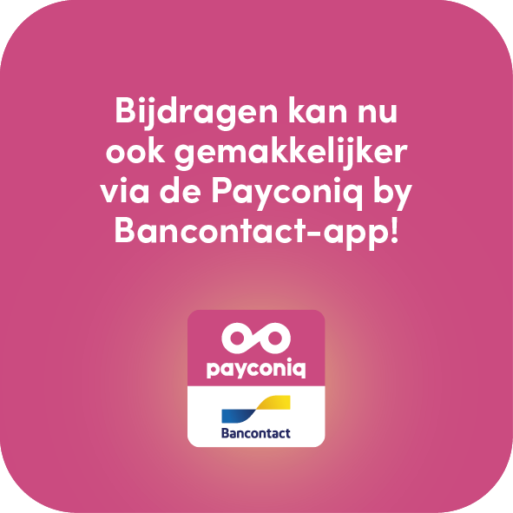
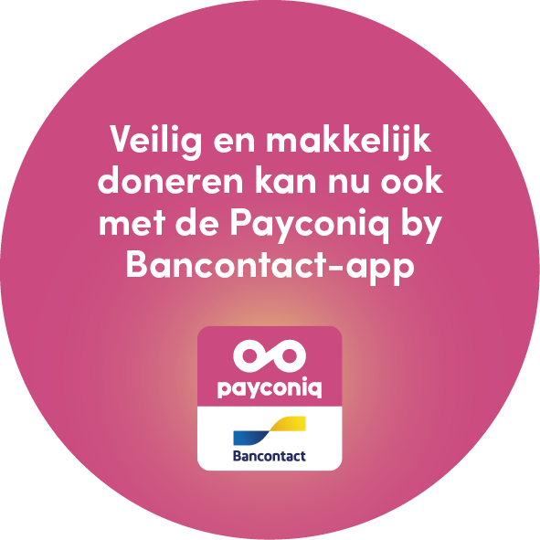
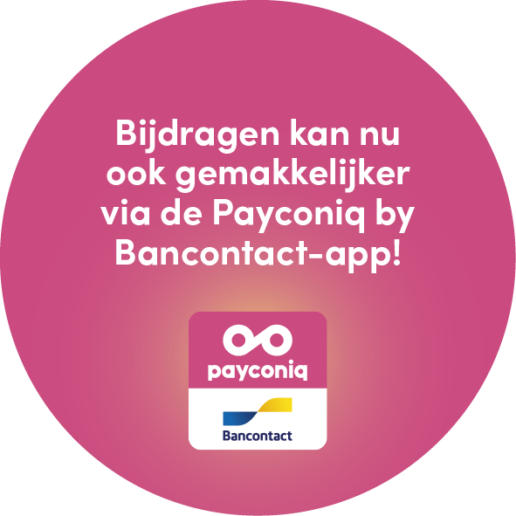
PROMOTIONAL MATERIAL FOR INTERNAL USE
You can easily implement one of the following visual elements in an existing visual from your organization to let your employees and volunteers know that they can now use the Payconiq by Bancontact app to collect donations.
24

Slide 23
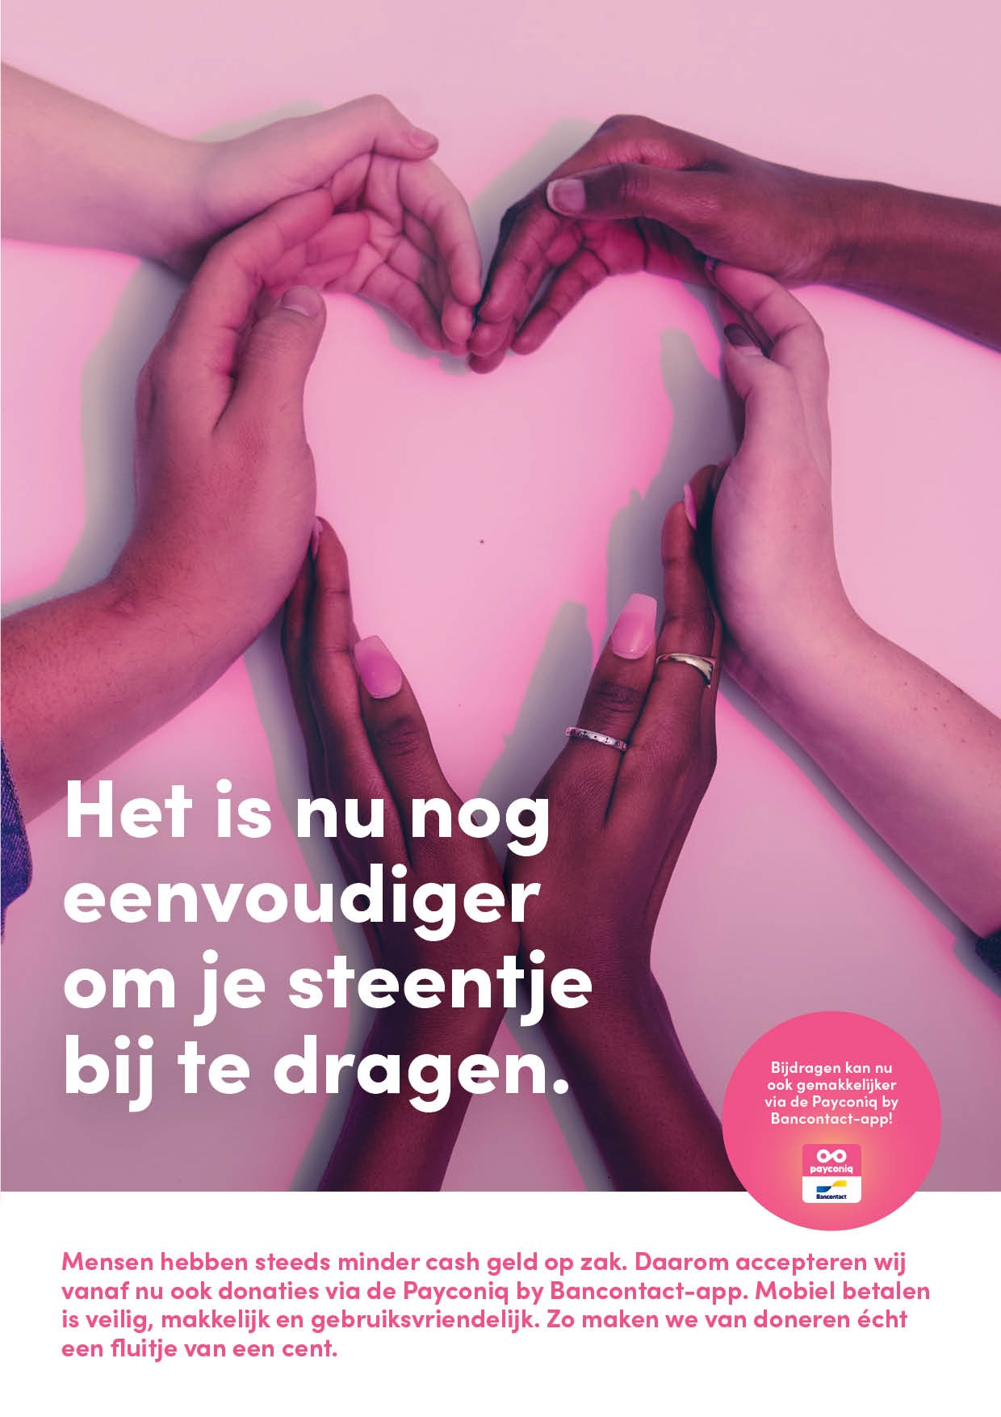
INTERNAL EXAMPLE
To show you how these elements can be implemented, we propose an example:
25

Slide 24
External communication
Let people know they can now make mobile donations using the Payconiq by Bancontact app or another banking app that supports Payconiq

Slide 25
External mailing
Mailing you can use to let people know they can now make mobile donations using the Payconiq by Bancontact app or another banking app that supports Payconiq

Slide 26
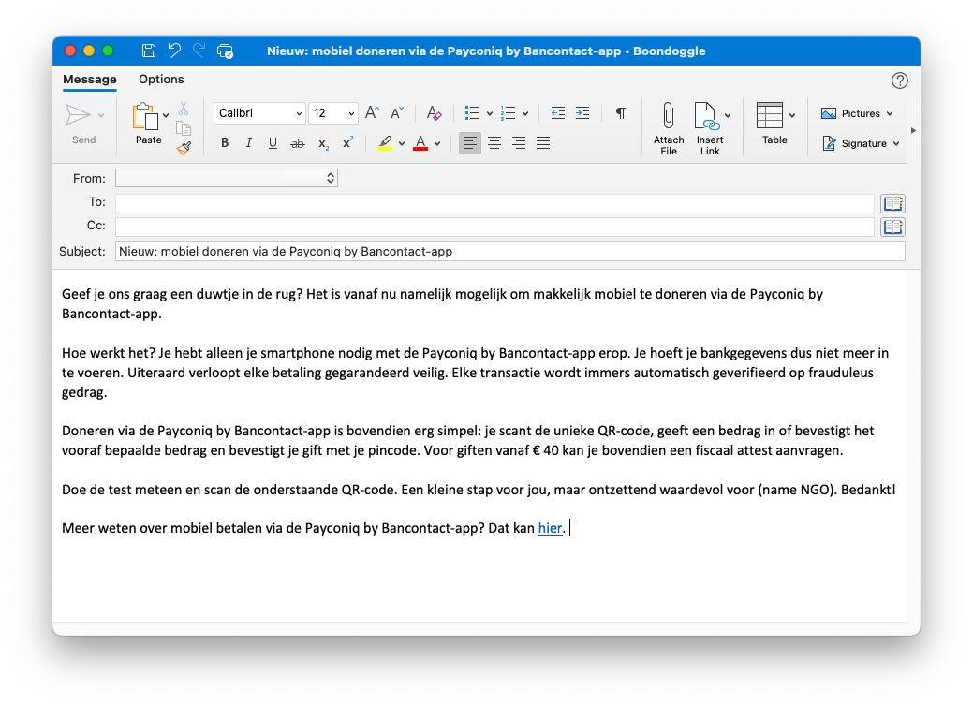
SHORT MAILING – ANNOUNCEMENT NL
You can use this external mailing to announce to your target audience that mobile donations are now an option via Payconiq. This mailing can either be integrated into an existing mail or serve as a news flash.
Please adapt as you wish to the TOV of your organization.
28
Notes:
Nieuw: mobiel doneren voor de Payconiq by Bancontact-app
Geef je ons graag een duwtje in de rug? Het is vanaf nu namelijk mogelijk om makkelijk mobiel te doneren via de Payconiq by Bancontact-app.
Hoe werkt het? … (huidige tekst behouden)
Doneren via de Payconiq by Bancontact-app is bovendien erg simpel: je scant de unieke QR-code, geeft een bedrag in of bevestigt het vooraf bepaalde bedrag en bevestigt je gift met je pincode. Voor giften vanaf € 40 kan je bovendien een fiscaal attest aanvragen.
… (huidige tekst behouden)

Slide 27
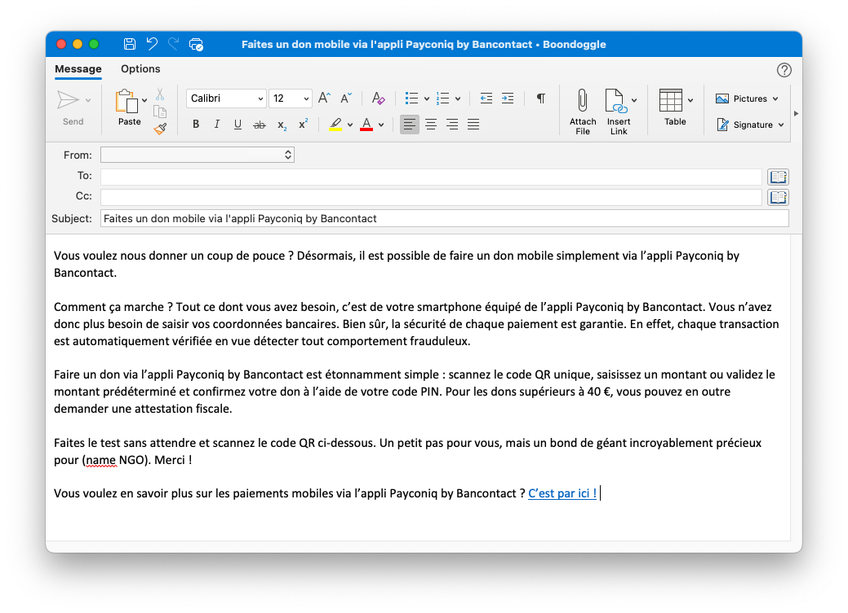
SHORT MAILING – ANNOUNCEMENT FR
You can use this external mailing to announce to your target audience that mobile donations are now an option via Payconiq. This mailing can either be integrated into an existing mail or serve as a news flash.
Please adapt as you wish to the TOV of your organization.
29

Slide 28
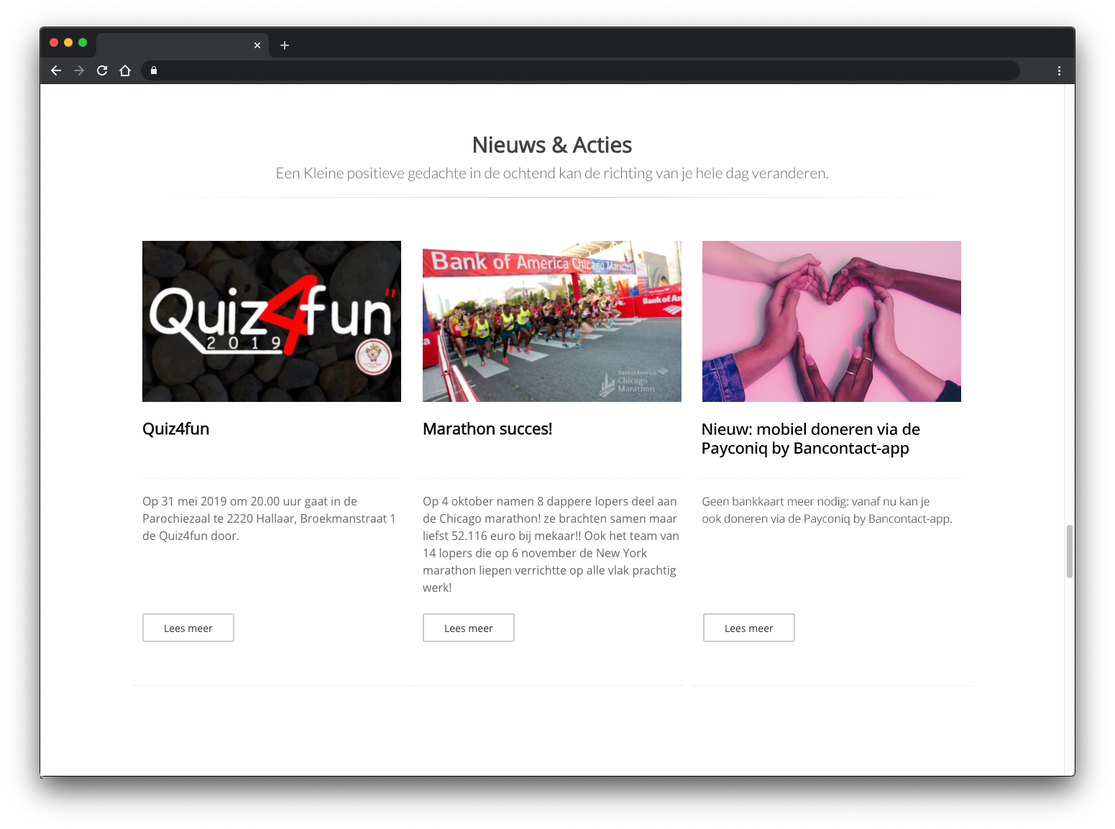
NEWS ITEM NL
You can integrate this news item on your website to announce that mobile donations are now an option via Payconiq.
30

Slide 29
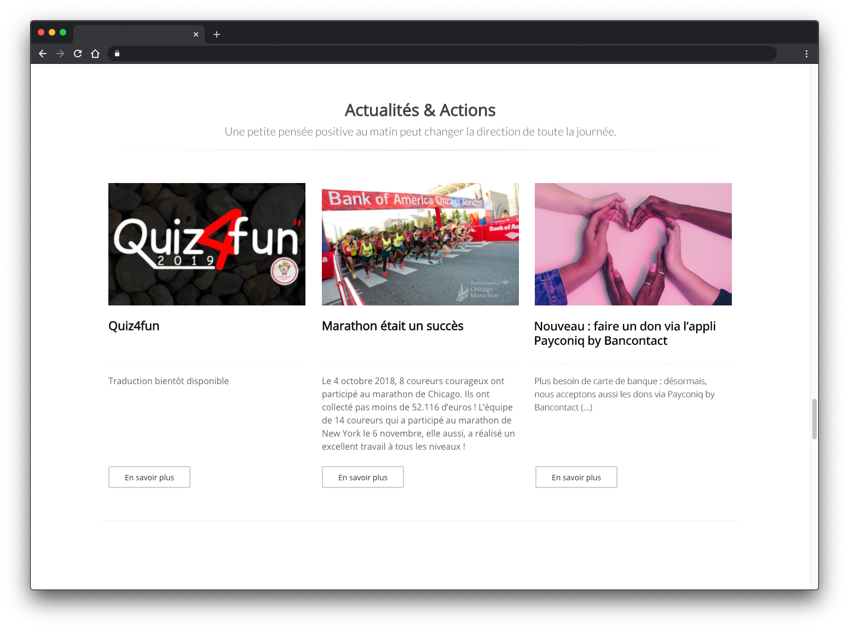
NEWS ITEM FR
You can integrate this news item on your website to announce that mobile donations are now an option via Payconiq.
31

Slide 30
MANUAL FOR CONSUMERS NL
To make sure that it is clear how the Payconiq by Bancontact app works it might be interesting to add this manual to your mail. You can simply implement the manual into your email by adding this sentence:
“Ontdek hieronder hoe makkelijk het is om mobiel te doneren via de Payconiq by Bancontact-app.”
21

Slide 31
MANUAL FOR CONSUMERS FR
To make sure that it is clear how the Payconiq by Bancontact app works it might be interesting to add this manual to your mail. You can simply implement the manual into your email by adding this sentence:
“Découvrez ci-dessous comme il est facile de faire un don mobile via l’appli Payconiq by Bancontact.”
22

Slide 32
External promotional material
This material can be used to let people know they can now make mobile donations using the Payconiq by Bancontact app or another banking app that supports Payconiq, and to make them familiar with Payconiq’s QR code and how to use it

Slide 33
PROMOTIONAL MATERIAL FOR EXTERNAL USE
You can easily integrate the Payconiq QR code in your external communication to announce that mobile donations are now an option via the Payconiq by Bancontact app. You can either use the QR code to collect a fixed amount, or to collect a variable amount.
35

Slide 34
QR code: variable amount

Slide 35
VARIABLE AMOUNT
If the QR code is used to collect a variable amount, the following copy proposals to introduce the QR code and the QR code designs are an option.
Steun ... en doneer met de Payconiq by Bancontact-app.
Doneer mobiel met de Payconiq by Bancontact-app en steun ...
Scan en doneer met de Payconiq by Bancontact-app.
Soutenez ... : faites un don mobile avec l’appli Payconiq by Bancontact.
Faites un don mobile avec l’appli Payconiq by Bancontact et soutenez ...
Scannez et faites un don avec l’appli Payconiq by Bancontact.
37

Slide 36
VARIABLE AMOUNT
Following Payconiq QR codes can be used in your external communication. Note that there are two options. When placing the QR code on a white background, please use the one with the magenta outline. When placing the QR code on a colored background, please use the one without magenta outline.
38

Slide 37
QR code: fixed amount

Slide 38
FIXED AMOUNT
If the QR code is used to collect a fixed amount, the following copy proposals to introduce the QR code and the QR code designs are an option.
Doneer € ... met de Payconiq by Bancontact-app.
Schenk € ... met de Payconiq by Bancontact-app.
Jij kan het verschil maken.
Scan en doneer € ... met de Payconiq by
Bancontact-app.
Steun onze vrijwilligers. Doneer € ... met de
Payconiq by Bancontact-app.
Donnez ... € avec l’appli Payconiq by Bancontact.
Donnez ... € avec l’appli Payconiq by Bancontact,
vous faites la différence.
Scannez et donnez ... € avec l’appli
Payconiq by Bancontact.
Soutenez nos volontaires/bénévoles. Donnez ... €
avec l’appli Payconiq by Bancontact.
40

Slide 39
FIXED AMOUNT
Following Payconiq QR codes can be used in your external communication. Note that there are two options. When placing the QR code on a white background, please use the one with the magenta outline. When placing the QR code on a colored background, please use the one without magenta outline.
41
Note: these QR codes are only examples, you will have to integrate your own QR code into the examples.

Slide 40
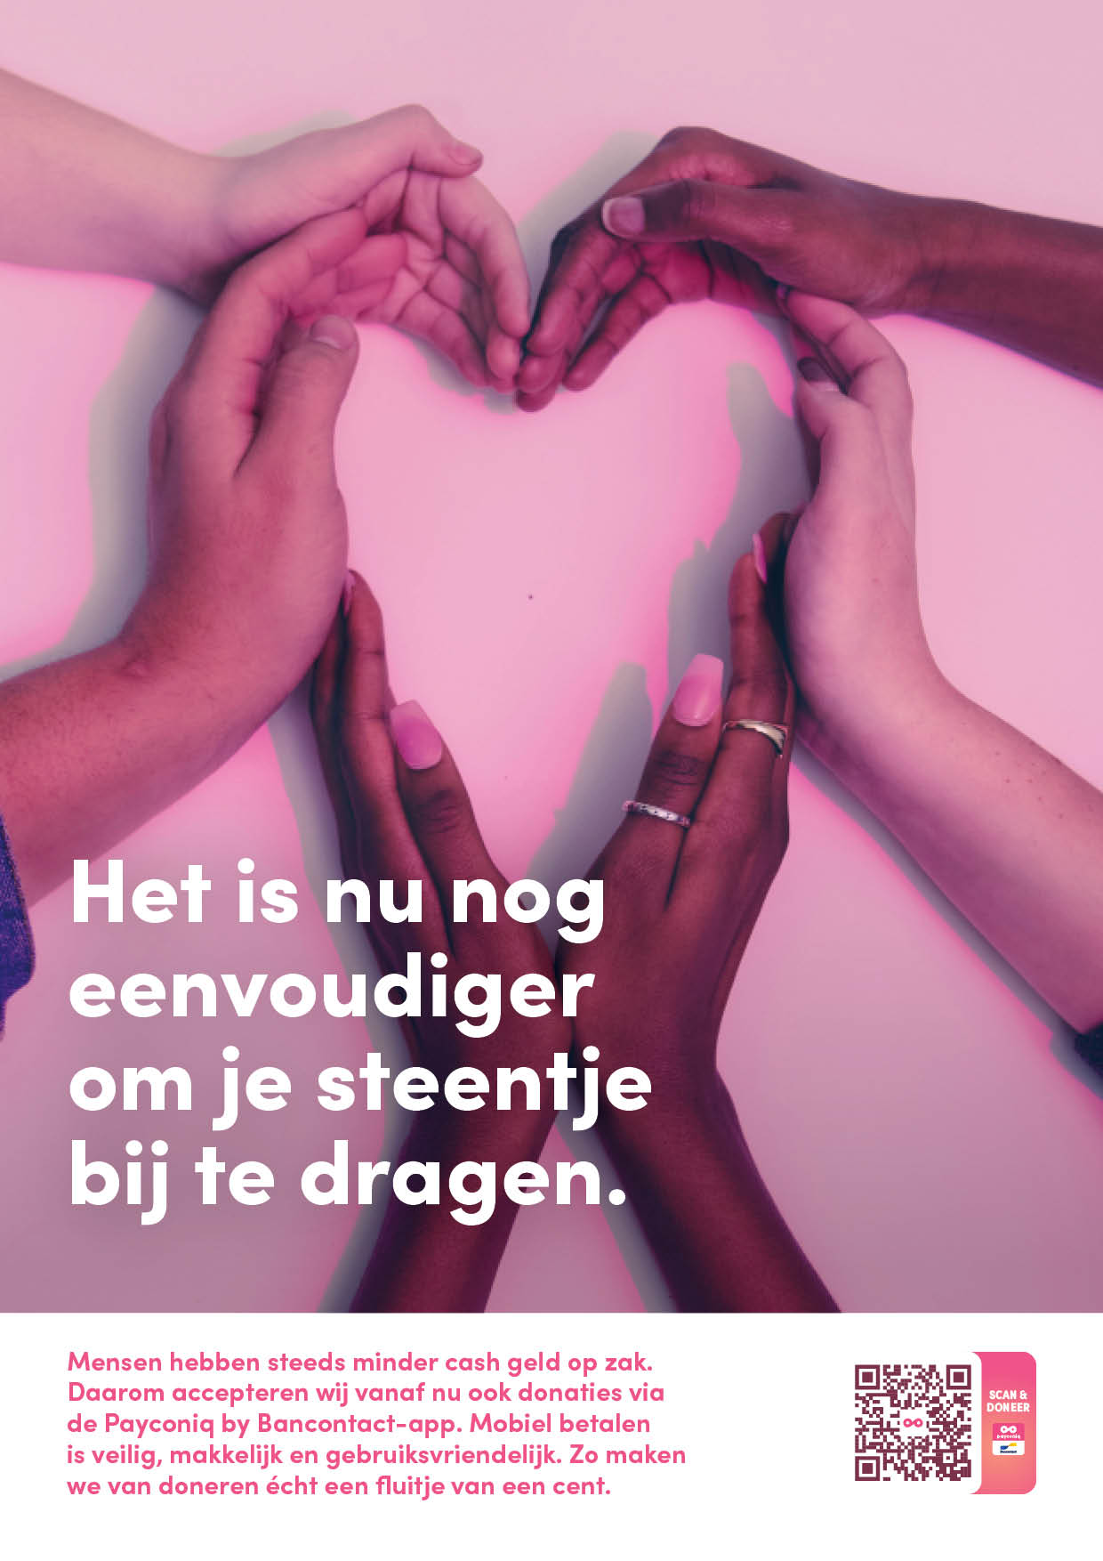
EXTERNAL EXAMPLE
To show you how the QR code can be integrated, we propose an example:
This QR code can be integrated in other
communication as well e.g. flyers and posters.
Note: this QR code is only an example, you will have to
integrate your own QR code into the communication.
42

Slide 41
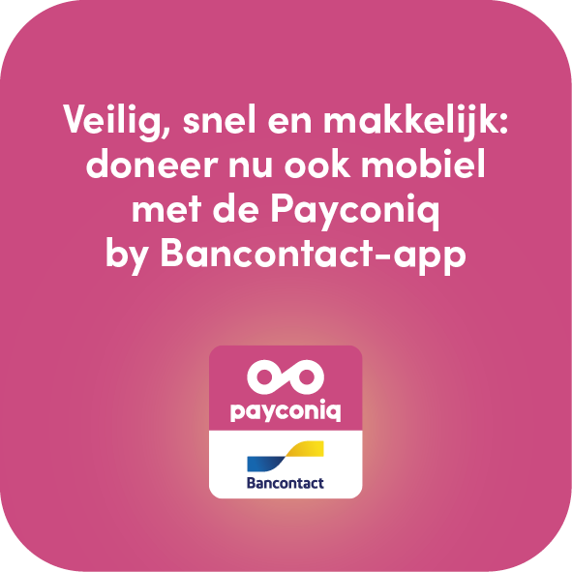
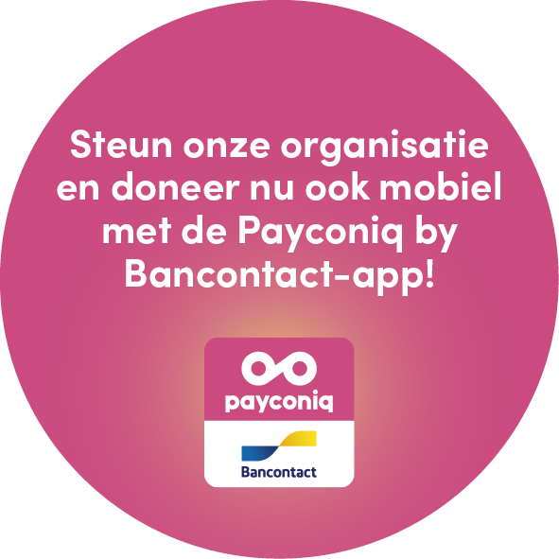
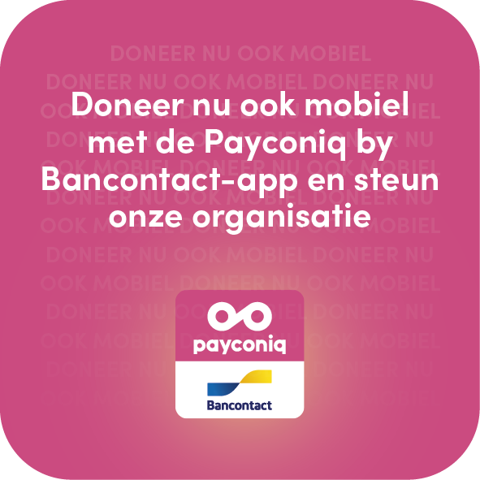
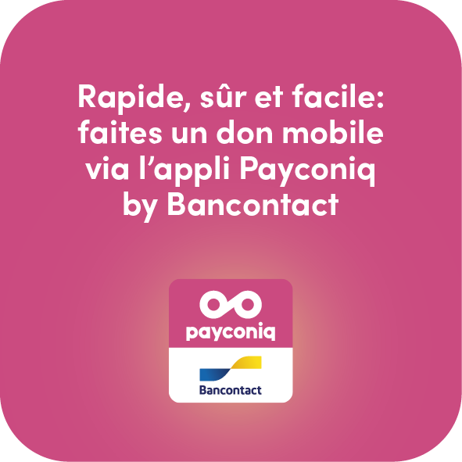
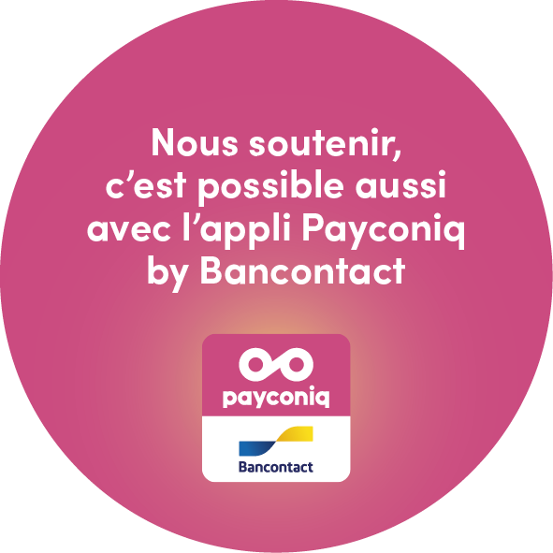
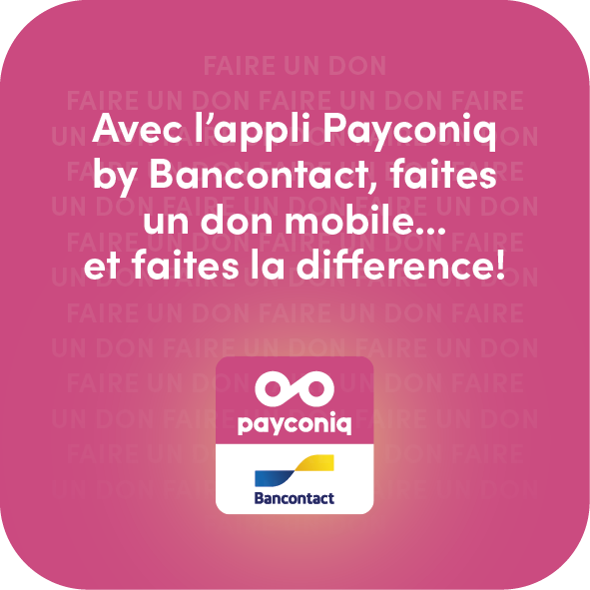
PROMOTIONAL MATERIAL FOR EXTERNAL USE
Do you want to integrate a visual element but do you prefer to announce that the Payconiq by Bancontact app is now an option, rather than immediately asking for donations via a QR code? In that case, you can integrate one of the following visual elements into your external communication.
43

Slide 42
3
Communication on website
The implementation of the Payconiq by Bancontact logo on the website

Slide 43
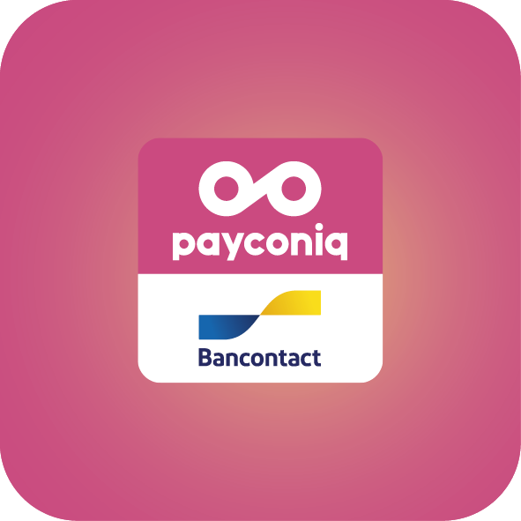
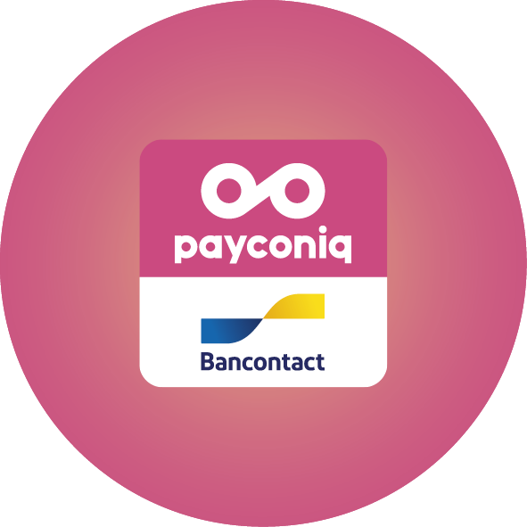
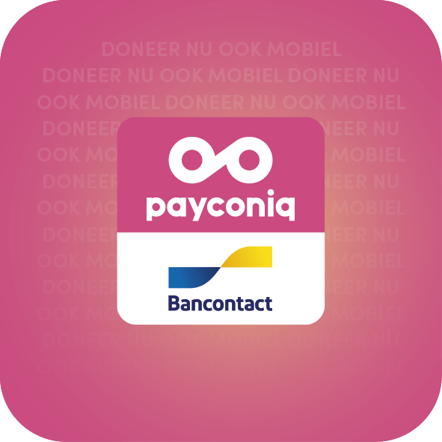
HOW TO ADD OUR LOGO TO YOUR WEBSITE?
You can also add one of the following options to your website to announce that the Payconiq by Bancontact app is now an option to make a donation.
Depending on the the background color of your website, there are two options:
  A visual with Payconiq’s magenta background
  A visual without the magenta background that can be used if the colors of your website don’t go well with it
45

Slide 44
WEBSITE EXAMPLE
There are several options to integrate the Payconiq by Bancontact logo on your website. Does your site have a blog? Then the Payconiq by Bancontact logo can subtly be integrated into the visual of a blog article talking about mobile donations with the Payconiq by Bancontact app.
46

Slide 45
4
Social media
• External communication
• LinkedIn - Facebook - Instagram

Slide 46
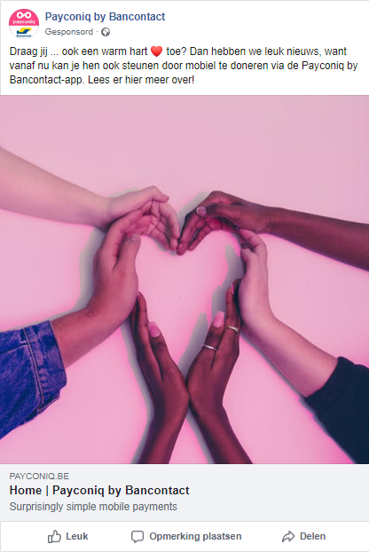

VISUAL ELEMENTS
Ready to announce this news on social media? Great! This is our suggestion in terms of visual:
Preferably, use a visual with the Payconiq by Bancontact logo.
48
Found the perfect visual? Nice! Now let’s look for the right body copy to join your visual.

Slide 47
FACEBOOK NL & FR
This copy can be posted on your Facebook page, to announce that Payconiq by Bancontact is now an option. Preferably, the Facebook post will link to the news item on your website or to the news item on the payconiq.be website.
COPY
Option 1: “Vous portez ... dans votre ❤️ ? Nous avons une bonne nouvelle : désormais, vous pouvez aussi nous soutenir via l’appli Payconiq by Bancontact. Lisez-en plus ici !”
Option 2: “⚡️ NOUVEAU ⚡️ Pour tous ceux qui veulent soutenir nos projets en cette période aussi : désormais, vous pouvez faire des dons via l’appli Payconiq by Bancontact ! 📲 Lisez-en plus dans cet article.”
Option 3: “Continuer à nous soutenir en ces temps de confinement ? 🏠 Désormais, nous acceptons aussi les paiements mobiles via l’appli Payconiq by Bancontact ! Lisez-en plus ici.”
Option 1: “Draag jij ... ook een warm hart ❤️ toe? Dan hebben we leuk nieuws, want vanaf nu kan je hen ook steunen door mobiel te doneren via de Payconiq by Bancontact-app of een bankapp die Payconiq ondersteunt. Lees er hier meer over!”
Option 2: “⚡️ NIEUW ⚡️ Voor iedereen die ... ook in deze tijden een warm hart toedraagt: vanaf nu kan je hen steunen door mobiel te doneren via de Payconiq by Bancontact-app of een bankapp die Payconiq ondersteunt! 📲 Lees er meer over in dit artikel!”
Option 3: “Wil jij ... blijven steunen vanuit je kot? 🏠 Goed nieuws, want vanaf nu kan dat door mobiel te doneren via de Payconiq by Bancontact-app of een bankapp die Payconiq ondersteunt. Lees er hier alles over!”
49

Slide 48
INSTAGRAM NL & FR
This copy can be posted on your Instagram feed, to announce that Payconiq by Bancontact is now an option.
COPY
Option 1: “Bonne nouvelle : faire un don est devenu plus simple que jamais 😌 Désormais, il est possible de faire un don mobile via l’appli Payconiq by Bancontact !”
Option 3: “Continuer à nous soutenir en ces temps de confinement ? 🏠 Désormais, nous acceptons aussi les paiements mobiles via Payconiq by Bancontact !”
Option 1: “Goed nieuws: doneren voor ...is zonet nog een tikje makkelijker geworden. 😌 Je kan nu namelijk ook mobiel doneren via de Payconiq by Bancontact-app of een bankapp die Payconiq ondersteunt!”
Option 2: “Wil jij ... blijven steunen vanuit je kot? 🏠 Goed nieuws, want vanaf nu kan je dat doen door mobiel te doneren via de Payconiq by Bancontact-app of een bankapp die Payconiq ondersteunt!”
50

Slide 49
Ready for the future of donating

